Slide 1
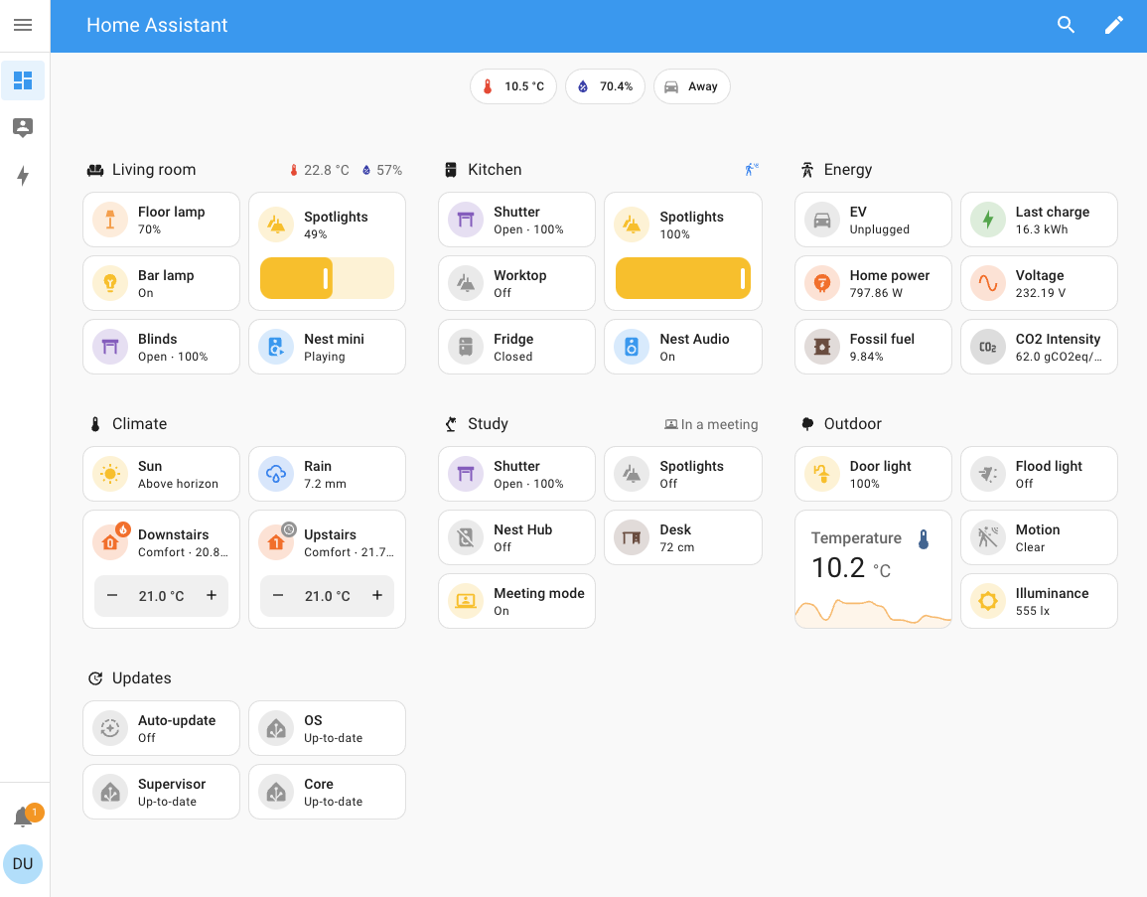
This is a screenshot from Home Assistant, which is a smart home platform.
Our Intelligent Control System will behave just like a smart home platform, we can read sensor value or do control over this platform

Slide 2
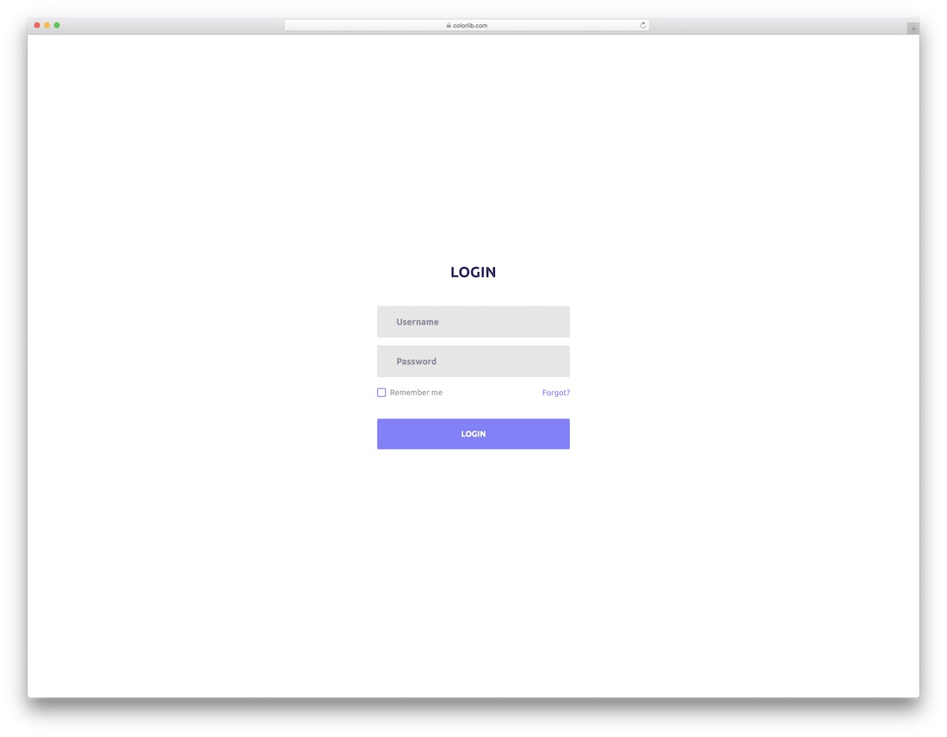
First, we have a simple login interface due to project requirement (some sort of authentication)
We can register one admin user and some random password, but we don’t need to have a user register function, we can create user from SQL command.
Also, we don’t have to implement the change password feature.
POST /auth/login

Slide 3
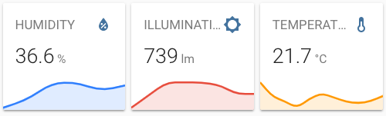

Intelligent Control System
Auto Refreshing: On/Off
Sensors
After login, we have this dashboard displayed
All sensors and controllers will display on this dashboard
Each sensor or controller will act like a card box, displaying its own data
Each sensor or controller can be clicked, if clicked go to detailed page
Top-right corner we can have a toggle to switch on/off auto refreshing, that means refresh every 5 seconds (pull data from server)
Button
12:39
Pressed
Controller
Passive Buzzer
Fan
Relay
Module
LED
45%
OFF
ON
OFF

Slide 4
Sensor/Controller Name | Data Type | Notes
Steam | Numerical | Display percentage value
Button | Event | Display Latest Event Time (HH:MM) and Event Info
Temperature | Numerical | Display Celsius
Humidity | Numerical | Display percentage value
Dew Point | Numerical | Display Celsius value
PIR | Event | Display Latest Event Time (HH:MM) and Event Info
Soil Humidity | Numerical | Display percentage value
Water Level | Numerical | Display percentage value
Ultrasonic | Numerical | Display distance
Photoresistor | Numerical | Display value (not percentage)
Buzzer | Event | Display Latest Event Time (HH:MM) and Event Info (When rang)
Fan | Event | Display speed status (0%-100%)
Relay | Event | Display ON/OFF status
LED | Event | Display ON/OFF status
Servo | Event | Display open status (OPEN|HALF_OPEN|CLOSED)

Slide 5
Intelligent Control System
Auto Refreshing: On/Off
Sensors
Home
Left navigation bar will have 3 icons
Home = Dashboard
Rules = Automation Rules
Settings = Reserved (Maybe have some settings under here, like configuration)
Button
Rules
Settings
12:39
Pressed
Controller
Passive Buzzer
Fan
Relay
Module
LED
45%
OFF
ON
OFF

Slide 6
Intelligent Control System
Auto Refreshing: On/Off
Sensors
GET /sensors/*/preview
POST /auth/logout
Button
12:39
Pressed
GET /sensors/light/chart
Controller
Passive Buzzer
Fan
Relay
Module
LED
45%
OFF
ON
OFF
POST /controllers/*

Slide 7
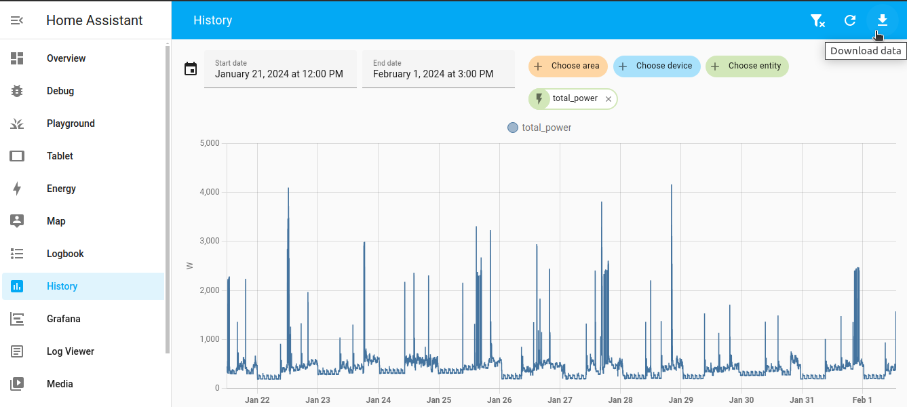
Intelligent Control System
Auto Refreshing: On/Off
Back
Humidity Sensor
This page is detailed page, it shows the history data of this sensor
Some sorts of sensor will be posting data each 5 second
The data will be numerical with timestamp, so it can be displayed as a chart/plot
We can define our custom data search time
Click back to return to the previous page
Search
Reset
1hr
3hr
6hr
1d
GET /sensors/light/chart

Slide 8
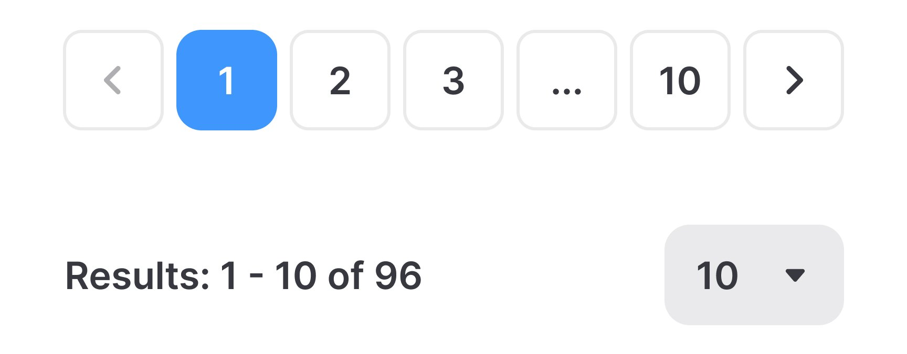
Intelligent Control System
Auto Refreshing: On/Off
Back
Button
This page is detailed page, it shows the history data of this sensor
The data will be event type, so it can’t be displayed using chart/plot, we will use list (table) to display the detailed event
We can define our custom data search time
Click back to return to the previous page
We can have a pagination controls
Search
Reset
1hr
3hr
6hr
1d
Event Time | Event Info
2024/11/18 21:32:33 | Released
2024/11/18 21:32:32 | Pressed
2024/11/18 09:12:22 | Released
2024/11/18 09:12:21 | Pressed
2024/11/17 14:19:07 | Released
2024/11/17 14:19:06 | Pressed

Slide 9
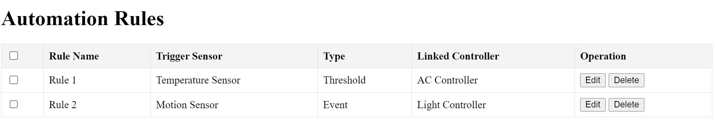
Intelligent Control System
Auto Refreshing: On/Off
GET /rules
Add
Delete
System will not have any rules at first, user can use ‘Add’ button to create rules
User can multi-select already created rules and delete them
DELETE /rules/{rule_id}

Slide 10
Intelligent Control System
Auto Refreshing: On/Off
Back
Add New Rule
All option/inputs is required on this page
Box with triangle icon means this is a dropdown list, user must select from a few options instead of typing
If user selected a trigger sensor, the ‘Type’ will be automatically changed accordingly
‘Event’ type will have ‘OP’ but no ‘Input Threshold Value’
Detailed relationship diagram attached in the next slide
Rule Name
Input Rule Name
Trigger Sensor
Select Sensor
Type
Threshold
OP
Input Threshold Value
Linked Controller
Select Controller
Select Action
POST /rules
OR
PUT /rules/{rule_id}
Save
Cancel

Slide 11
Trigger Sensor | Type | OP | Select Controller | Select Action
Steam.Value | Threshold | >= | Buzzer | 0s | 5s | 10s | 30s
Steam.Percentage |  | > | Fan | 0% | 25% | 50% | 75% | 100%
DHT11.Humidity |  | <= | Relay | Active (ON) | Inactive (OFF)
DHT11.Temperature.Celsius |  | < | LED | Active (ON) | Inactive (OFF)
DHT11.Temperature.Fahrenhei |  | == | Servo | OPEN | HALF_OPEN | CLOSED
DHT11.Temperature.Kelvin |  | != | LCD | 5s | 10s
DHT11.DewPoint.Celsius |  | User must input a threshold value
Soil.Value
Soil.Percentage
Water.Value
Water.Percentage
Ultrasonic.Value
Light.Value
Light.Percentage
Button | Event | Pressed
 |  | Released
PIR |  | Detected
 |  | Not Detected
Relay / LED |  | Active (ON)
 |  | Inactive (OFF)
Servo |  | OPEN | HALF_OPEN | CLOSED
Trigger Sensor and Select Controller can’t be the same object otherwise it will create a loop

